Slide 1
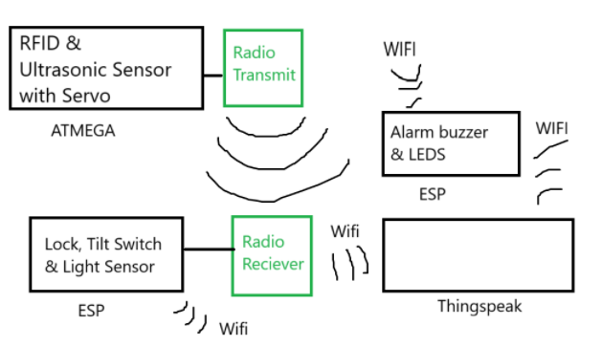
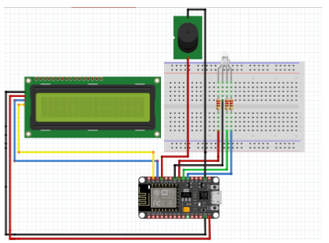
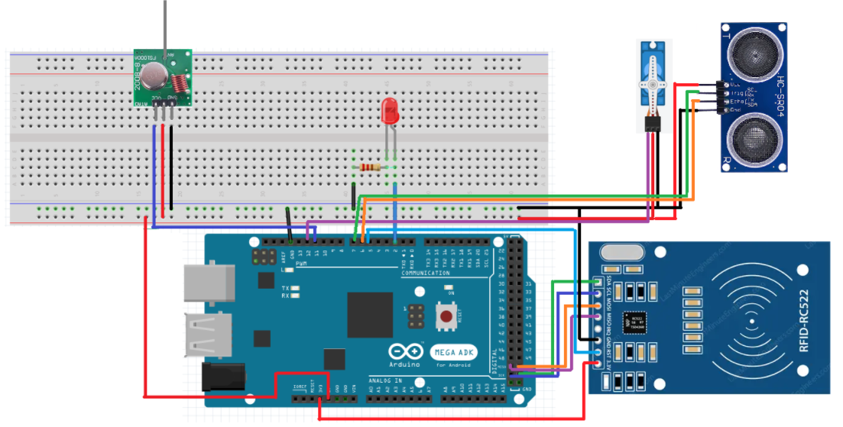
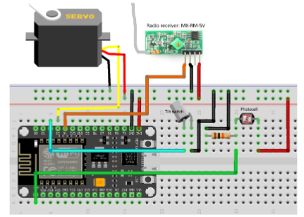
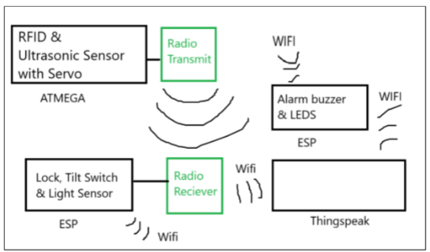
Security System
Security system
Introduction
Jarl Pallesen - s183424 Thomas Niebuhr - s136513
Federico Morace - s241797 Anna-Beatrice Berciu - s232417
& Anders Hansen - s225271
To protect your home and valuables you need a system that can detect intruders and alert you that an intruder is in your home, so you can effectively use the second amendment to protect your home. That’s exactly what this systems aims to do!
The system consists of 3 parts communicating with radio and Wi-Fi.
Alarm System
The alarm system will pull data from the thingspeak and use this to determine if the alarm should go off. If the alarm goes off it will play a very amazing sound inspired by the Italian Police sirens™. Additionally, it will also make some LED’s blink blue and red to scare potential intruders away.
RFID & Spinning ultrasonic sensor
Radio
An RFID scanner detects if a key fob is present and compares the ID of the key fob to an access ID. If the key fob has access the lock is toggled. If they aren’t the lock is locked.
Additionally, there is an ultrasonic sensor sitting on top of a servo motor slowly scanning the nearby area if an intruder is present.
Every ½ second the status is sent using radio, indicating if the lock is on or off and if somebody is close to the ultrasonic sensor.
To communicate between the RFID & Ultrasonic sensor to the ESP radio frequency is used. The RFID part sends the wanted status of the lock and if someone is close to the ultrasonic sensor. The ESP then receives this to control the lock accordingly and to send data to thingspeak to control the alarm.
Thingspeak
Thingspeak is used to communicate from the ESP to the alarm over Wi-Fi. It sends a signal from the ESP indicating that the alarm should go. It also sends if door is locked and threat so it can be viewed on thingspeak.
Lock, Tilt Switch & Light Sensor
Conclusion
The ESP will control the lock depending on the signal received and get measurements from a tilt switch that can be on a handle and the light sensor that will sense if any light is on. The ESP can use this to determine if the alarm should go off or not and send this to the thingspeak.
A security system has been made, that can effectively detect an intruder and use a key fob to turn on and off the system. The system uses Wi-Fi communication and radio communication to effectively move data around.
System overview
The system consist of a few different parts. On one arduino there is an RFID sensor, that can scan a keyfob and a Ultrasonic sensor sitting on top of a servo motor, that will scan if somebody is nearby. Depending on this a radio signal will be sent to an ESP8266.
The ESP will control the lock depending on the signal received and get measurements from a tilt switch that can be on a handle and the light sensor that will sense if any light is on. The ESP can send this to thingspeak.
The ESP will control the lock depending on the signal received and get measurements from a tilt switch that can be on a handle and the light sensor that will sense if any light is on. The ESP can send this to thingspeak.

